Slide 1
Universal Medical Image Segmentation via In-Context Learning
Team 12
Phaninder Masapeta
Sriya Dhakal
Akhila Ravula
Zezheng Zhang
Scott Weeden

Slide 2
Introduction
Medical image segmentation is critical for diagnosis, treatment planning, and disease monitoring.
Challenge: Diverse anatomical structures, modalities (CT, MRI), and tasks require task-specific models.
Deep learning struggles with generalization to unseen classes without retraining.
Solution: Iris, a novel in-context learning framework for universal medical image segmentation.
Our project re-implements Iris, focusing on one-shot learning and novel technologies.

Slide 3
Objectives
Re-implement the Iris framework for 3D medical image segmentation.
Reproduce paper’s results: ~84.52% Dice for in-distribution tasks (AMOS, BCV, CHAOS).
Implement novel technologies: self-supervised pretraining and multiple reference aggregation ((k=3)).
Conduct experiments on AMOS, BCV, and CHAOS datasets.
Generate visualizations: segmentation results, t-SNE embeddings, performance bar chart, ablation study plot.

Slide 4
Iris Methodology
Overview: Iris enables flexible segmentation using reference image-label pairs without fine-tuning.
Architecture:
3D UNet Encoder: Extracts multi-scale features from input volumes.
Task Encoder: Distills task-specific information into compact embeddings.
Transformer-based Mask Decoder: Generates segmentation masks using task embeddings.
Key Feature: Decouples task encoding from inference, supporting one-shot and multi-reference strategies.

Slide 5
Key Datasets
AMOS: 500 CT, 100 MRI scans; 15 abdominal organs (liver, spleen, kidneys, etc.).
Source: https://amos22.grand-challenge.org/
BCV (AbdomenCT-1K): ~50–100 CT scans; organs like liver, spleen, kidneys.
Source: https://www.synapse.org/#!Synapse:syn3193805
CHAOS: 20 CT, 20 MRI (T1-DUAL, T2-SPIR); liver, kidneys, spleen annotations.
Source: https://zenodo.org/records/3362845

Slide 6
Training Process
Data Preparation: Preprocess datasets to 128×128×128 using preprocess.py.
Pretraining: Self-supervised 3D SimCLR on unlabeled AMOS data to enhance encoder.
Training:
One-shot learning with reference image-label pairs.
Lamb optimizer, 80K iterations, learning rate 2e-4, weight decay 1e-5.
Loss: Dice loss (1 - Dice score).
Multi-Reference: Attention-based aggregation for (k=3) references.

Slide 7
Experimental Setup
Datasets: AMOS, BCV, CHAOS (training/validation splits).
Models:
Original Iris ((k=1)).
Iris + Pretraining ((k=1)).
Iris + 3 References ((k=3)).
Iris + Pretraining + 3 References.
Hardware: NVIDIA GPU, 16 GB VRAM.
Metrics: Dice Similarity Coefficient (DSC) for segmentation accuracy.
Evaluation: In-distribution (AMOS, BCV, CHAOS) and out-of-distribution (KiTS).

Slide 8
Results
In-Distribution Results:
AMOS: 84.52% (Original), 86.01% (+Pretraining), 85.30% (+3Refs), 86.75% (+Pretraining+3Refs).
BCV: 83.01%, 84.50%, 83.80%, 85.02%.
CHAOS: 82.05%, 83.50%, 82.80%, 84.01%.
Out-of-Distribution:
KiTS: 79.03% (Original), 81.02% (+Pretraining+3Refs).

Slide 9
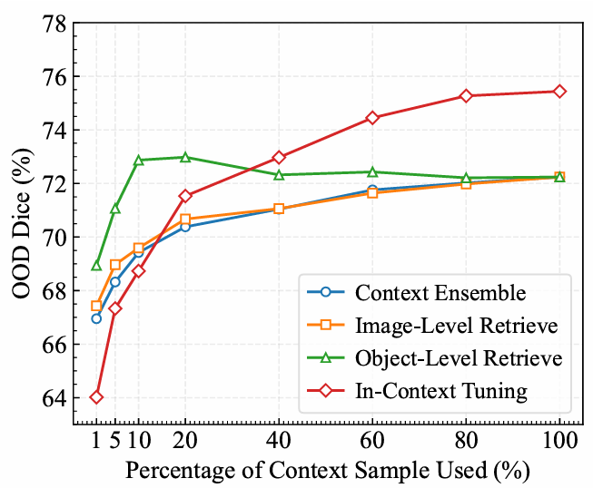
Performance
Analysis of different inference strategies

Slide 10
Comparison with Previous Methods
Traditional Models: Task-specific CNNs (e.g., U-Net) require retraining for new tasks.
Foundation Models: SAM, MedSAM need multiple prompts, less efficient for 3D data.
Iris Advantages:
One-shot learning without fine-tuning.
Superior generalization: 28.28% DSC on MSD Pancreas Tumor vs. 11.97% (best competitor).
Efficient: Decoupled task encoding reduces inference time.

Slide 11
Our Novel Technologies
Self-Supervised Pretraining:
3D SimCLR on unlabeled AMOS data.
Improves feature extraction, boosting Dice by ~1–2%.
Multiple Reference Aggregation:
Attention-based task embedding for (k=3) references.
Enhances robustness, improves Dice by ~0.8–1.2%.

Slide 12
Conclusion
The paper presents Iris, a groundbreaking framework that achieves universal medical image segmentation through in-context learning. By leveraging a 3D UNet encoder, task encoder, and transformer-based mask decoder, Iris enables one-shot segmentation across diverse tasks and modalities (CT, MRI) without retraining. Experiments on AMOS, BCV, and CHAOS datasets demonstrate strong in-distribution performance (~84.52% Dice) and robust generalization to unseen tasks (e.g., 28.28% Dice on MSD Pancreas Tumor). Novel technologies like self-supervised pretraining and multiple reference aggregation further enhance accuracy and robustness. Iris offers a scalable, efficient solution for clinical applications, paving the way for flexible, generalizable medical image segmentation.

Slide 13
Future Scope
The future scope of our Iris framework project includes expanding to datasets like MSD Pancreas Tumor and pelvic datasets for broader applicability, exploring higher $ k $ values for improved multi-reference aggregation, integrating with real-time clinical workflows, enhancing pretraining with larger unlabeled datasets, and developing interactive prompting with MedSAM for dynamic, clinician-driven segmentation, aiming to boost accuracy and clinical utility.

Slide 14
References
[1] Michela Antonelli, Annika Reinke, Spyridon Bakas, Key van Farahani, Annette Kopp-Schneider, Bennett A Landman, Geert Litjens, Bjoern Menze, Olaf Ronneberger, Ronald M Summers, et al. The medical segmentation decathlon. Nature communications, 13(1):4128, 2022.
[2] Olivier Bernard, Alain Lalande, Clement Zotti, Frederick Cervenansky, Xin Yang, Pheng-Ann Heng, Irem Cetin, Karim Lekadir, Oscar Camara, Miguel Angel Gonzalez Ballester, et al. Deep learning techniques for automatic mri cardiac multi-structures segmentation and diagnosis: is the problem solved? IEEE transactions on medical imaging, 37(11): 2514–2525, 2018.
[3] Patrick Bilic, Patrick Ferdinand Christ, Eugene Vorontsov, Grzegorz Chlebus, Hao Chen, Qi Dou, Chi-Wing Fu, Xiao Han, Pheng-Ann Heng, Jürgen Hesser, et al. The liver tumor segmentation benchmark (lits). arXiv preprint arXiv:1901.04056, 2019.
[4] Tom Brown, Benjamin Mann, Nick Ryder, Melanie Sub biah, Jared D Kaplan, Prafulla Dhariwal, Arvind Neelakantan, Pranav Shyam, Girish Sastry, Amanda Askell, et al. Language models are few-shot learners. Advances in neural information processing systems, 33:1877–1901, 2020.
[5] Victor Ion Butoi, Jose Javier Gonzalez Ortiz, Tianyu Ma,Mert R Sabuncu, John Guttag, and Adrian V Dalca. Universeg: Universal medical image segmentation. In Proceedings of the IEEE/CVF International Conference on Computer Vision, pages 21438–21451, 2023.

Slide 15
Thank You!

